Slide 1
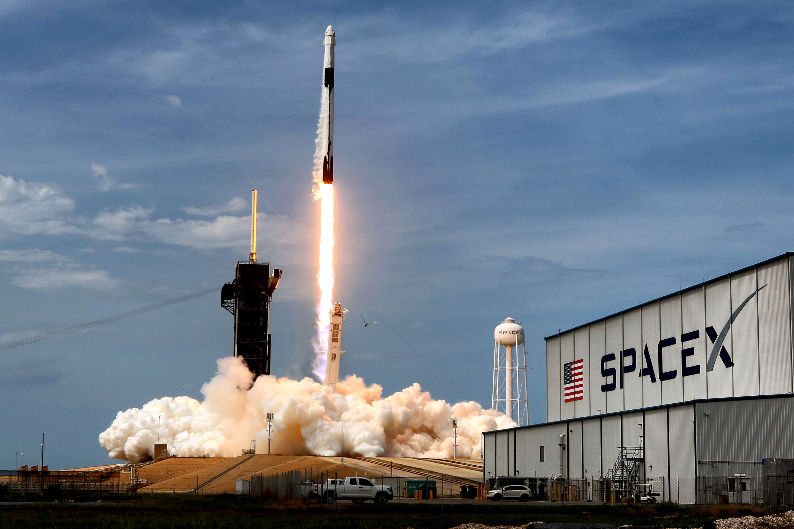







Applied Data Science Capstone - SpaceX Historical Data Study
Yiwen Zhou
2021 Dec 26

Slide 2


OUTLINE
Completed the required Executive Summary slide (1 pt)
Completed the required Introduction slide (1 pt)
Completed the required data collection and data wrangling methodology related slides (1 pt)
Completed the required EDA and interactive visual analytics methodology related slides (3 pts)
Completed the required predictive analysis methodology related slides (1 pt)
Completed the required EDA with visualization results slides (6 pts)
Completed the required EDA with SQL results slides (10 pts)
Completed the required interactive map with Folium results slides (3 pts)
Completed the required Plotly Dash dashboard results slides (3 pts)
Completed the required predictive analysis (classification) results slides (6 pts)
Completed the required Conclusion slide (1 pts)
Applied your creativity to improve the presentation beyond the template (1 pts)
Displayed any innovative insights (1 pts)

Slide 3

EXECUTIVE SUMMARY and INTRODUCTION
Completed the required Executive Summary slide (1 pt)
Completed the required Introduction slide (1 pt)
Overall historical data is not enough to have too many statistically significant conclusions.
But we do have a good view of historical trend SpaceX launches and landings:
Over the time success rate of landing got much improved;
Over the time SpaceX has been exploring more new orbits;
Over the time SpaceX is capable for more payload mass.
We have various nice visualizations of historical data:
Various static plots and tables using plotly or seaborn;
Interactive statistical plots using dash and geographical plots using folium.
Predictions of landing outcome has accuracy of 85%.
Notes:
Completed the required Executive Summary slide (1 pt)
Completed the required Introduction slide (1 pt)

Slide 4
Data collection and data wrangling methodology
Use "requests.get(spacex_url)" to retrive data and tables from website;
Turn the above data into a pandas data frame to manipulate data. For example, the "groupby" method is frequently used;
Can also use "BeautifulSoup" to parse the web information;
"ipython-sql" makes it easier to do SQL operations in python jupyter notebook;
Use "seaborn", "plotly.express" or simply "matplotlib.pyplot" to plot figures in order to visualize data;
Use "dash" to make interactive data visualizations.
Completed the required data collection and data wrangling methodology related slides (1 pt)
Notes:
Completed the required data collection and data wrangling methodology related slides (1 pt)

Slide 5
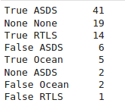
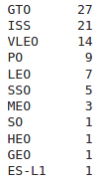
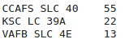
SpaceX Data collection and data wrangling results
Completed the required data collection and data wrangling methodology related slides (1 pt)
The following are the landing outcomes of SpaceX:
The following are the occurrence of each orbit lauched for SpaceX:
The following are the Launch Sites of SpaceX:
Notes:
Completed the required data collection and data wrangling methodology related slides (1 pt)

Slide 6
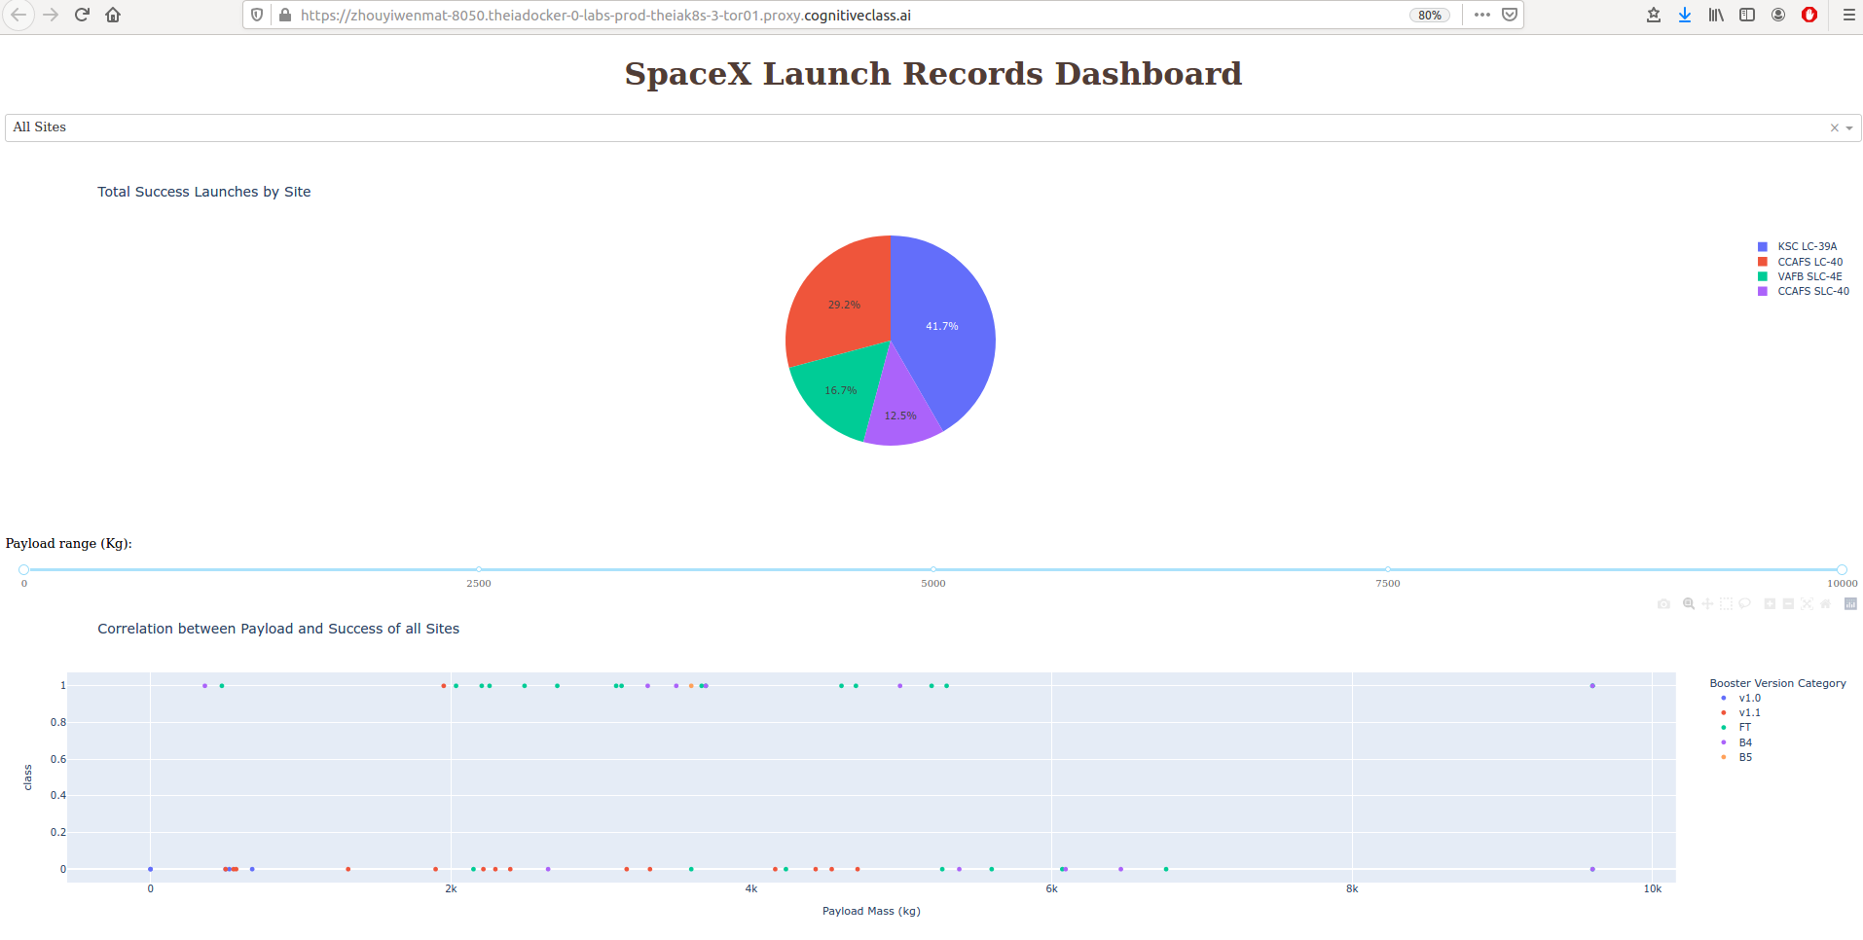
SpaceX Interactive Visualizations
Completed the required EDA and interactive visual analytics methodology related slides (3 pts)
Completed the required Plotly Dash dashboard results slides (3 pts)
Notes:
Completed the required EDA and interactive visual analytics methodology related slides (3 pts)
Completed the required Plotly Dash dashboard results slides (3 pts)

Slide 7
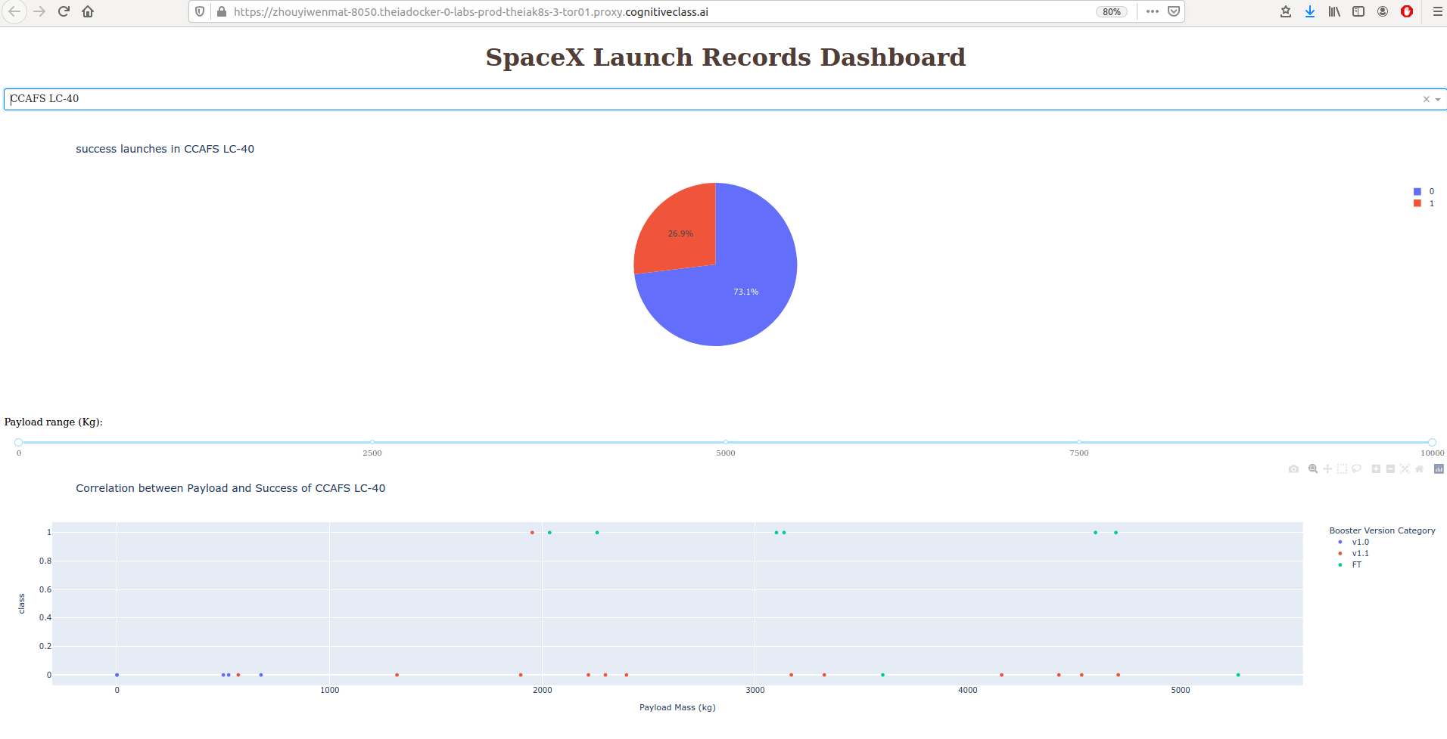
SpaceX Interactive Visualizations
Completed the required EDA and interactive visual analytics methodology related slides (3 pts)
Completed the required Plotly Dash dashboard results slides (3 pts)
Notes:
Completed the required EDA and interactive visual analytics methodology related slides (3 pts)
Completed the required Plotly Dash dashboard results slides (3 pts)

Slide 8
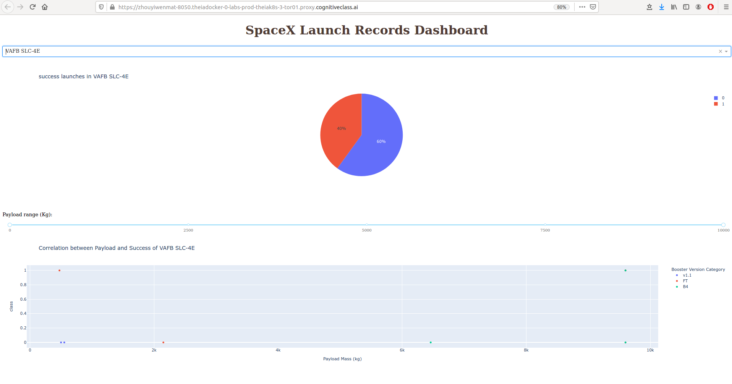
SpaceX Interactive Visualizations
Completed the required EDA and interactive visual analytics methodology related slides (3 pts)
Completed the required Plotly Dash dashboard results slides (3 pts)
Notes:
Completed the required EDA and interactive visual analytics methodology related slides (3 pts)
Completed the required Plotly Dash dashboard results slides (3 pts)

Slide 9
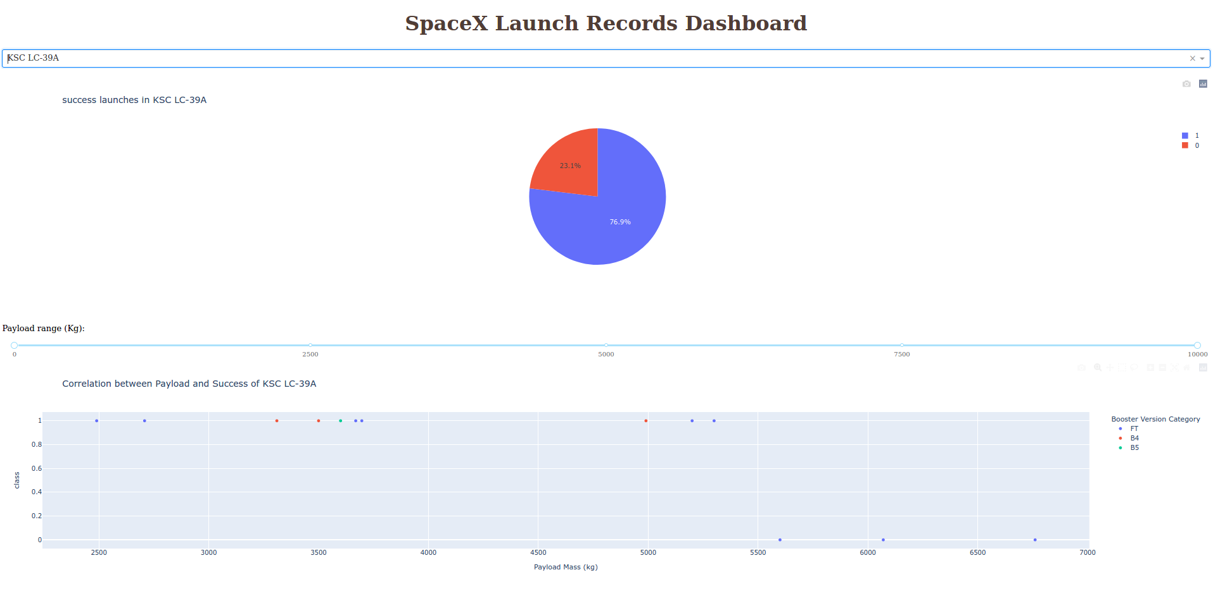
SpaceX Interactive Visualizations
Completed the required EDA and interactive visual analytics methodology related slides (3 pts)
Completed the required Plotly Dash dashboard results slides (3 pts)
Notes:
Completed the required EDA and interactive visual analytics methodology related slides (3 pts)
Completed the required Plotly Dash dashboard results slides (3 pts)

Slide 10
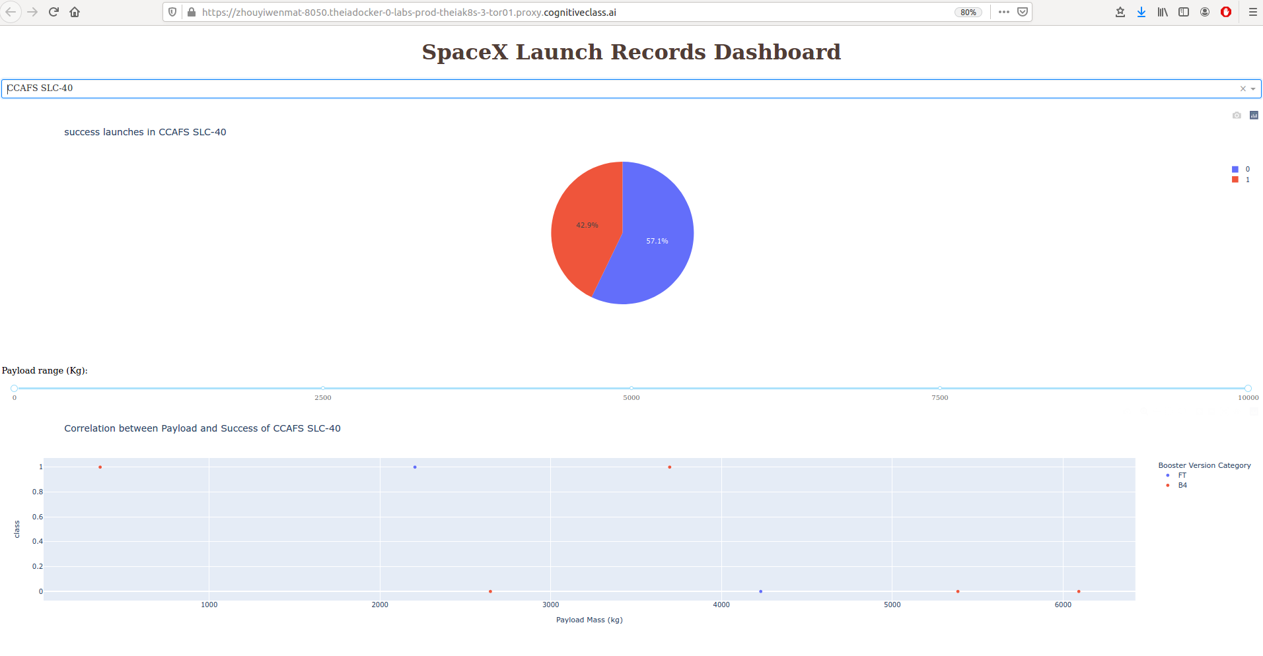
SpaceX Interactive Visualizations
Completed the required EDA and interactive visual analytics methodology related slides (3 pts)
Completed the required Plotly Dash dashboard results slides (3 pts)
Notes:
Completed the required EDA and interactive visual analytics methodology related slides (3 pts)
Completed the required Plotly Dash dashboard results slides (3 pts)

Slide 11
Predictive Analysis Methodology and results
Completed the required predictive analysis methodology related slides (1 pt)
Completed the required predictive analysis (classification) results slides (6 pts)
Goal: Predict whether a landing of Space X will be successful or not.
Method | Logistic Regression | Support Vector Machine | Decision Tree | K-Means
Best hyper-parameters | C = 0.01, penalty = l2, solver = lbfgs | C=1.0, gamma = 0.0316, kernel = sigmoid | criterion = gini, max_depth = 6, max_features = sqrt, min_samples_leaf = 4 | algorithm = auto, n_neighbors = 10, p=1
Train set accuracy | 0.846 | 0.848 | 0.891 | 0.848
Test set Score | 0.833 | 0.833 | 0.889 | 0.833
False positive rate | 0.167 | 0.167 | 0.111 | 0.167
False negative rate | 0.0 | 0.0 | 0.0 | 0.0
Conclusion: |  |  | Best performance
Common problems: False positive rate is all too high.
Notes:
Completed the required predictive analysis methodology related slides (1 pt)
Completed the required predictive analysis (classification) results slides (6 pts)

Slide 12
EDA with visualization results
Completed the required EDA with visualization results slides (6 pts)
Exploratory Data Analysis results:
More recent flights (with larger flight number) have been carrying more and more pay load mass, and success rate is also higher;
Most of the unsuccessful landings were earlier flight numbers, which were mostly launched from CCAFS SLC 40;
From VAFB SLC 4E never launched more than 10,000 pay load mass;
SSO has highest success landing rate (100%); VLEO also has high success rate (85.7%); GTO / ISS / LEO / MEO / PO have similar success rate (50.0% ~ 70.0%);
Latest (more recent) flight numbers have been trying new variety of orbits;
Some orbits (like LEO / GTO / SSO) seem to have relatively consistent pay load masses;
Success rate has been improved a lot in recent years. Current success rate is about 85%.
In the next few pages we show some plots supporting the above conclusions:
Notes:
Completed the required EDA with visualization results slides (6 pts)

Slide 13
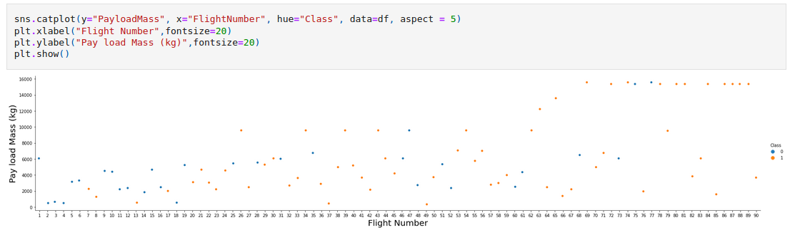
EDA with visualization results
Completed the required EDA with visualization results slides (6 pts)
1. More recent flights (with larger flight number) have been carrying more and more pay load mass, and success rate gets higher:
Notes:
Completed the required EDA with visualization results slides (6 pts)

Slide 14
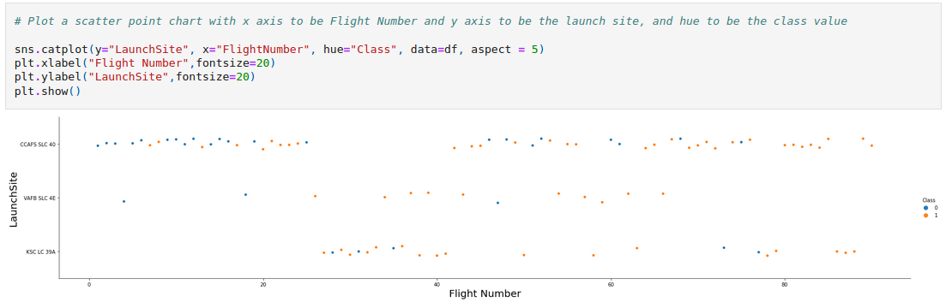
EDA with visualization results
Completed the required EDA with visualization results slides (6 pts)
2. Most of the unsuccessful landings were earlier flight numbers, which were mostly launched from CCAFS SLC 40:
Notes:
Completed the required EDA with visualization results slides (6 pts)

Slide 15
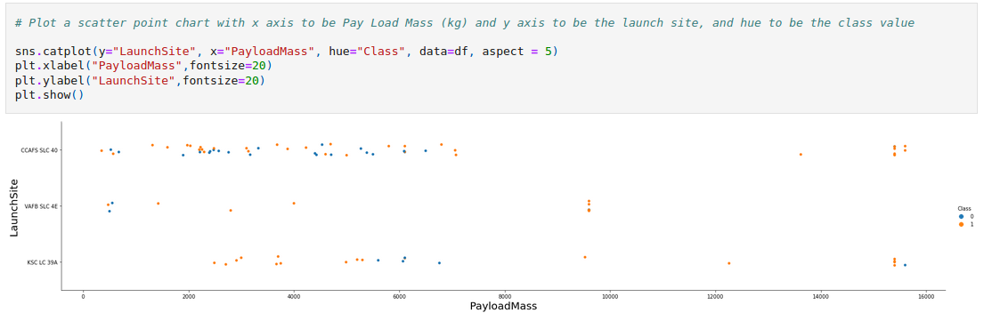
EDA with visualization results
Completed the required EDA with visualization results slides (6 pts)
3. Most of the unsuccessful landings were earlier smaller pay load mass launched from CCAFS SLC 40;
4. From VAFB SLC 4E never launched more than 10,000 pay load mass:
Notes:
Completed the required EDA with visualization results slides (6 pts)

Slide 16
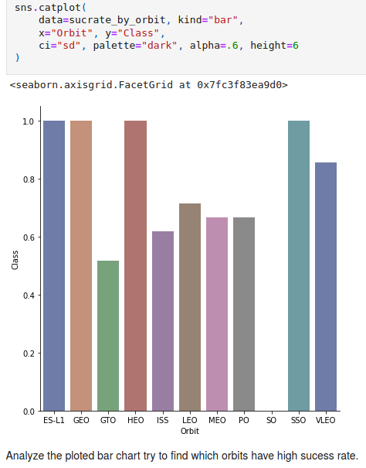
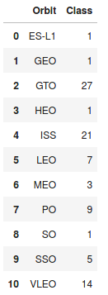
EDA with visualization results
Completed the required EDA with visualization results slides (6 pts)
Counts of launches for each orbit:
ES-L1 / GEO / HEO / SO each have only 1 sample point, so the success rate of them is statistical insignificant;
Among GTO / ISS / LEO / MEO / PO / SSO / VLEO:
SSO has highest success landing rate (100%)
VLEO also has high success rate (85.7%)
The rest have similar success rate (50.0% ~ 70.0%)
Notes:
Completed the required EDA with visualization results slides (6 pts)

Slide 17
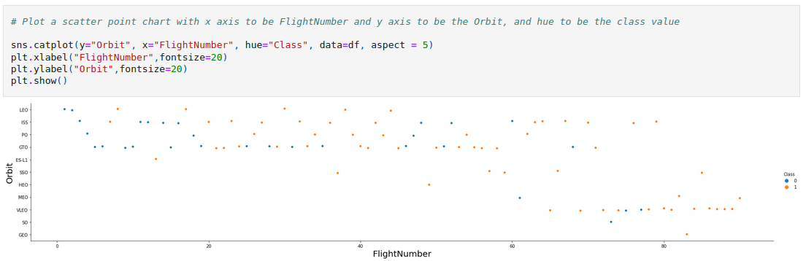
EDA with visualization results
Completed the required EDA with visualization results slides (6 pts)
6. We can see that latest (more recent) flight numbers have been trying different orbits:
Notes:
Completed the required EDA with visualization results slides (6 pts)

Slide 18
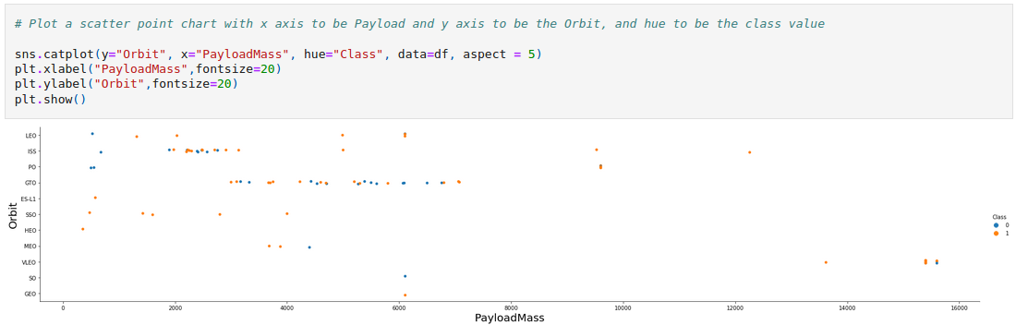
EDA with visualization results
Completed the required EDA with visualization results slides (6 pts)
7. Some orbits (like LEO / GTO / SSO) seem to have relatively consistent pay load masses:
Notes:
Completed the required EDA with visualization results slides (6 pts)

Slide 19
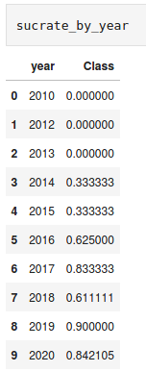
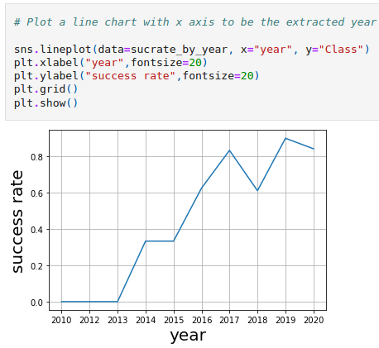
EDA with visualization results
Completed the required EDA with visualization results slides (6 pts)
8. Success rate has been improved a lot in recent years.
Notes:
Completed the required EDA with visualization results slides (6 pts)

Slide 20
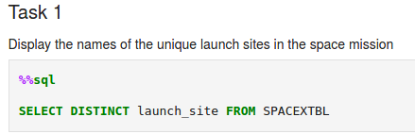
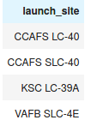
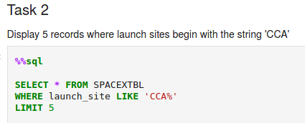
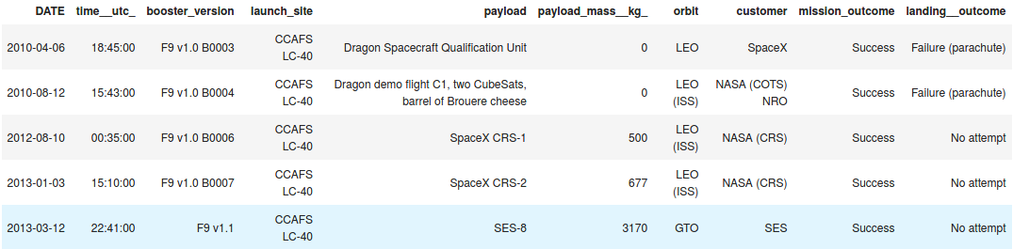
EDA with SQL results
Completed the required EDA with SQL results slides (10 pts)
Notes:
Completed the required EDA with SQL results slides (10 pts)

Slide 21
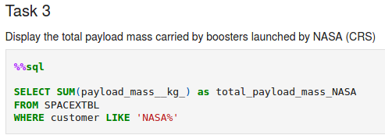
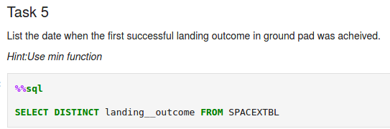
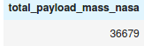
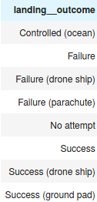
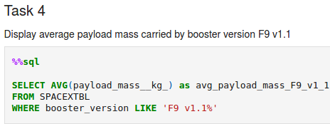
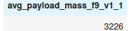
EDA with SQL results
Completed the required EDA with SQL results slides (10 pts)
Notes:
Completed the required EDA with SQL results slides (10 pts)

Slide 22
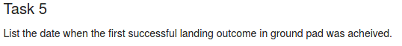
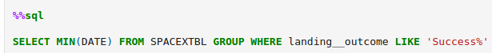
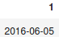
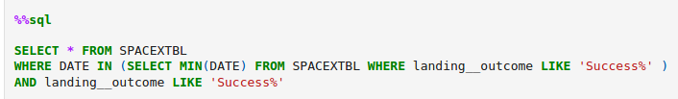
EDA with SQL results
Completed the required EDA with SQL results slides (10 pts)
Notes:
Completed the required EDA with SQL results slides (10 pts)

Slide 23
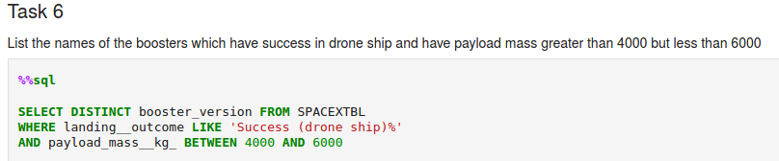
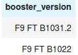
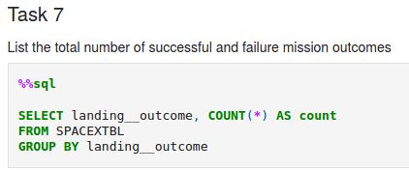
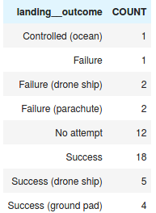
EDA with SQL results
Completed the required EDA with SQL results slides (10 pts)
Notes:
Completed the required EDA with SQL results slides (10 pts)

Slide 24
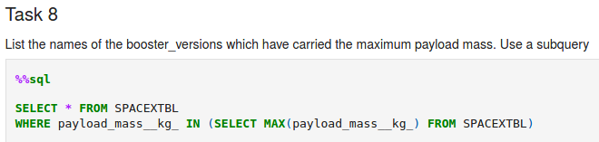
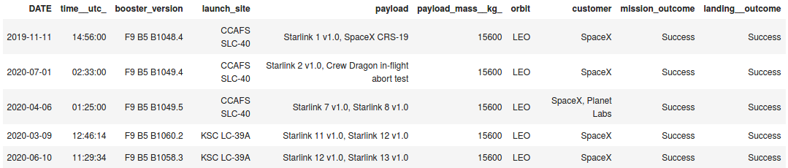
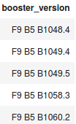
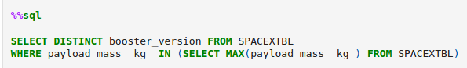
EDA with SQL results
Completed the required EDA with SQL results slides (10 pts)
Notes:
Completed the required EDA with SQL results slides (10 pts)

Slide 25
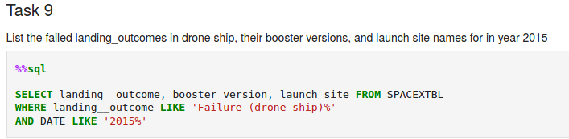
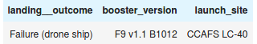
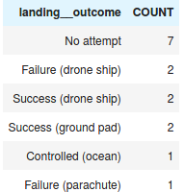
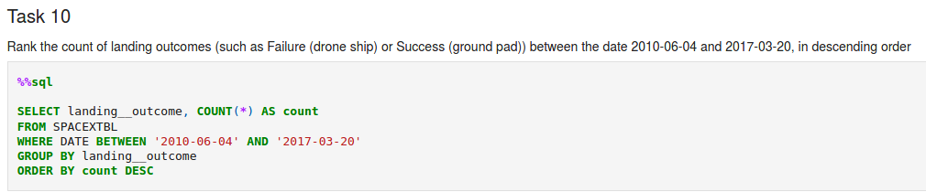
EDA with SQL results
Completed the required EDA with SQL results slides (10 pts)
Notes:
Completed the required EDA with SQL results slides (10 pts)

Slide 26
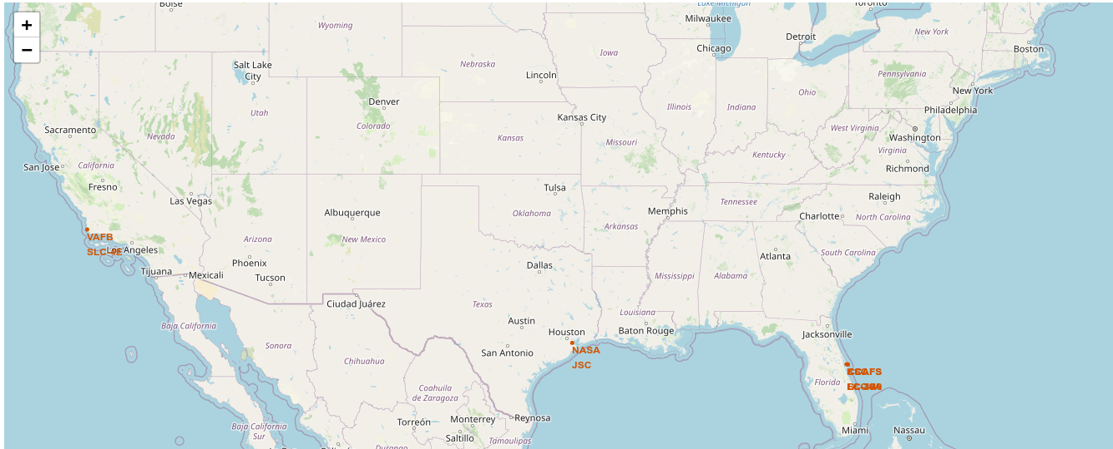
Interactive Map With Folium results
Completed the required interactive map with Folium results slides (3 pts)
Notes:
Completed the required interactive map with Folium results slides (3 pts)

Slide 27
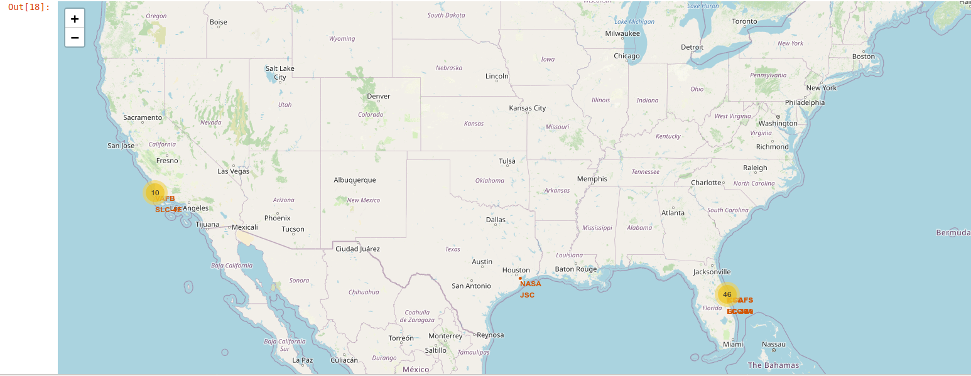
Interactive Map With Folium results
Completed the required interactive map with Folium results slides (3 pts)
Notes:
Completed the required interactive map with Folium results slides (3 pts)

Slide 28
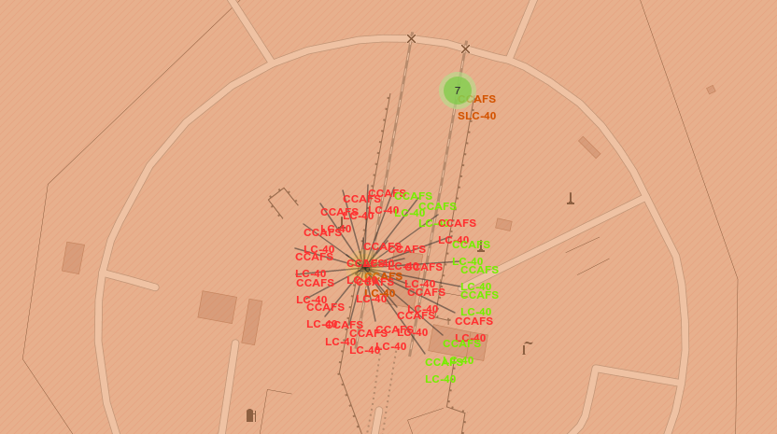
Interactive Map With Folium results
Completed the required interactive map with Folium results slides (3 pts)
Notes:
Completed the required interactive map with Folium results slides (3 pts)

Slide 29

CONCLUSION
Completed the required Conclusion slide (1 pts)
Overall historical data is not enough to have too many statistically significant conclusions.
We have a good view of historical trend SpaceX launches and landings:
Over the time success rate of landing got much improved;
Over the time SpaceX has been exploring more new orbits;
Over the time SpaceX is capable for more payload mass.
We have various nice visualizations of historical data:
Various static plots and tables using plotly or seaborn;
Interactive statistical plots using dash and geographical plots using folium.
Predictions of landing outcome has accuracy of 85%.
Notes:
Completed the required Conclusion slide (1 pts)

